Slide 1
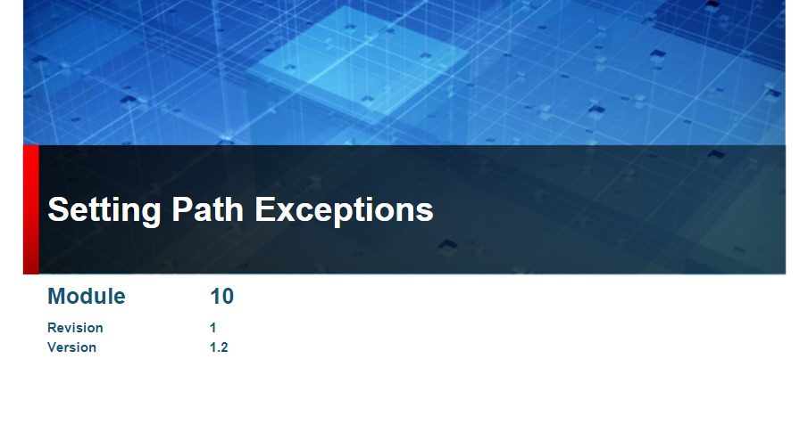

Slide 2
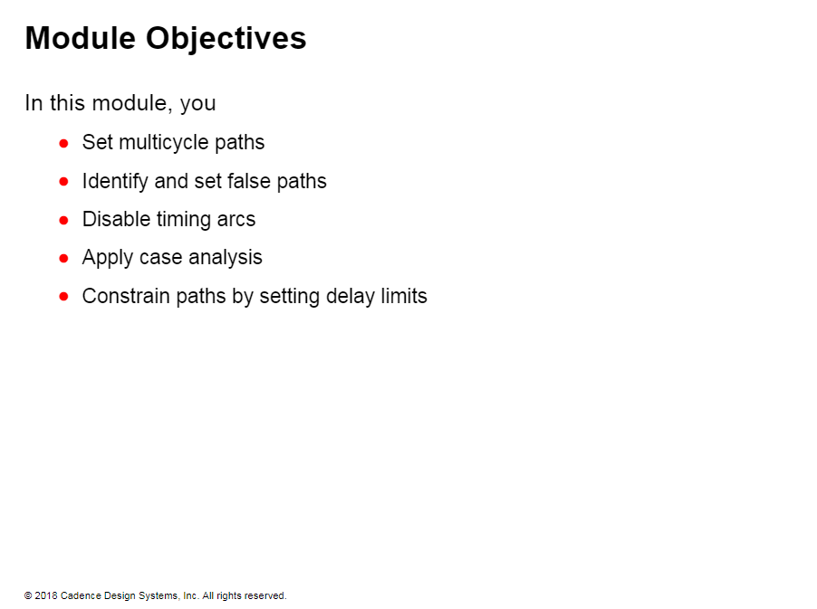

Slide 3
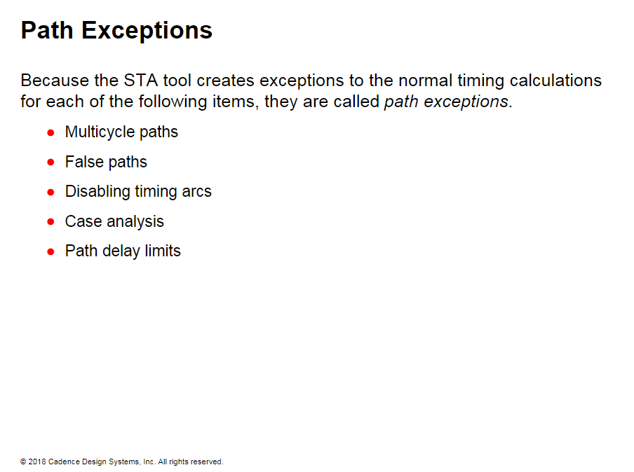

Slide 4
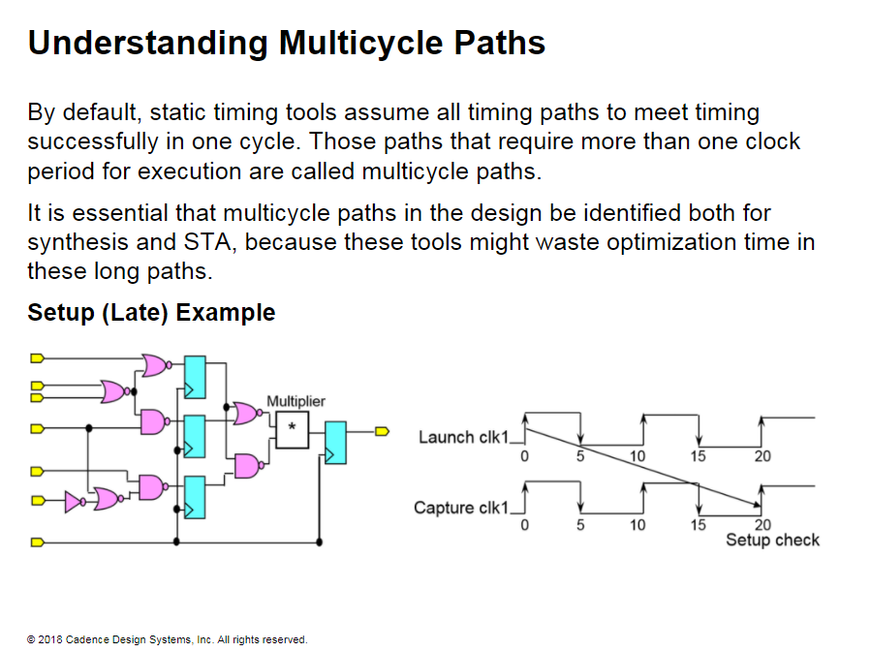

Slide 5
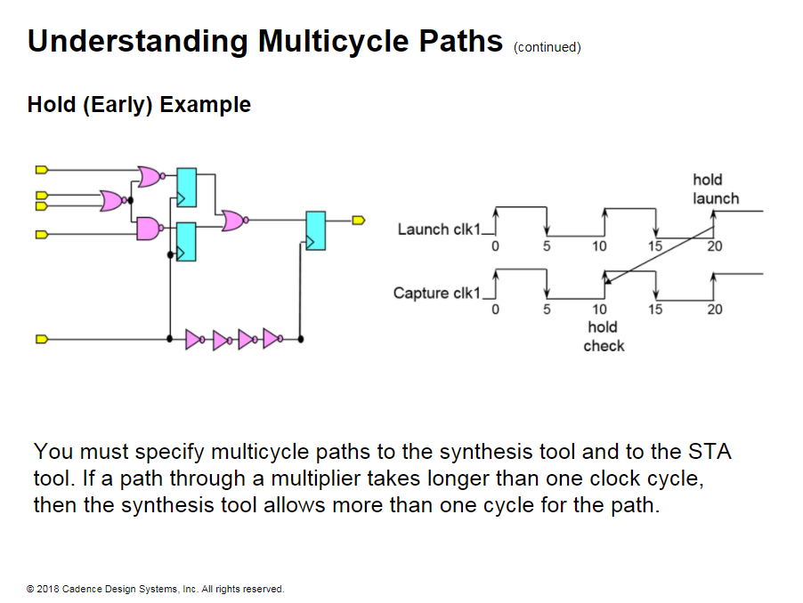

Slide 6
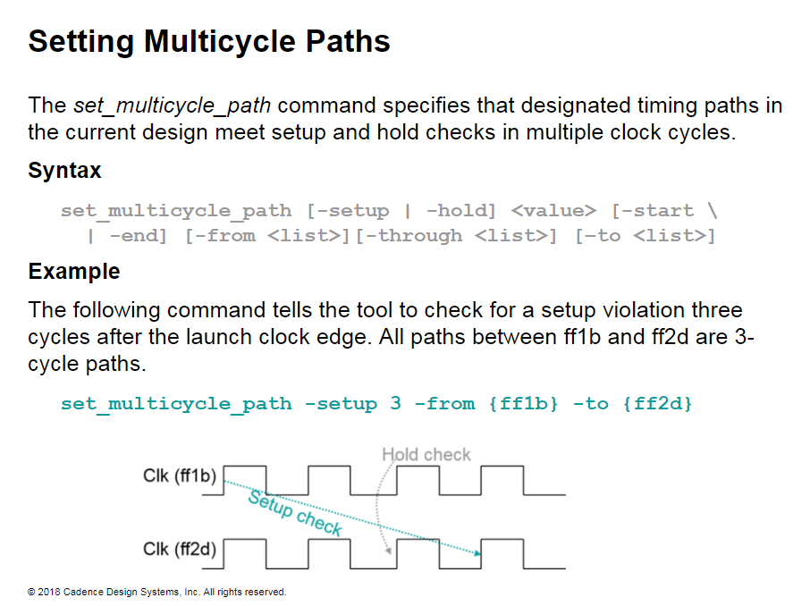
Notes:
Setting Multicycle Paths
In PrimeTime. because the set_multicvele_path -setup command sets hold as well, the set_multicvele_path -setup
example above increases setup by 2 more cycles. but also moves the hold check by -2 cycles.
Thus, this command sets a hold multicycle constraint on the path. Therefore, in paths that do not have a hold multicyle, such as paths in a multiplier, you need to reset the hold.

Slide 7
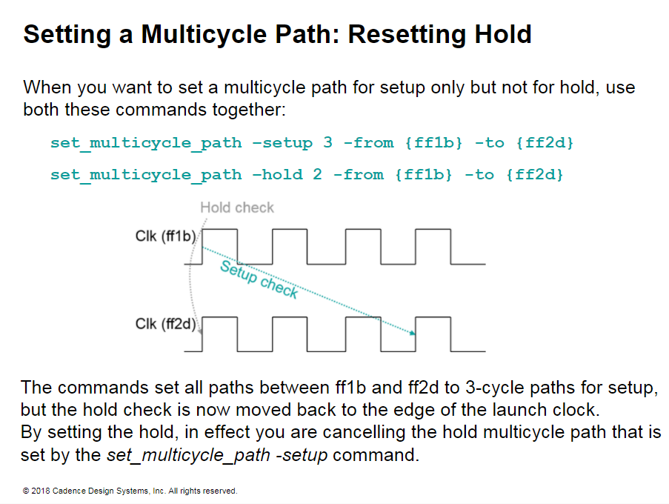
Notes:
Setting a Multicycle Path: Resetting Hold
According to PrimeTime behavior, the second set_multicvele_path -hold command adds back the cycles taken away by the set_multicvele_path -setup command.

Slide 8
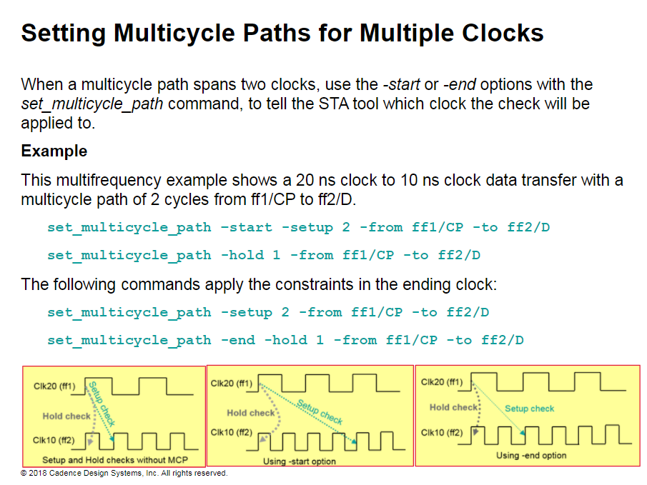
Notes:
Setting Multicycle Paths for Multiple Clocks
By default, the setup checks are relative to the clock at the end point, and hold checks are relative to the clock at the start point.
In this example. the launch edge and capture edge of the multicycle path are in two different clocks. Thus. the constraints shown in this example are not applied relative to the same clock. and you might not get the expected results.

Slide 9
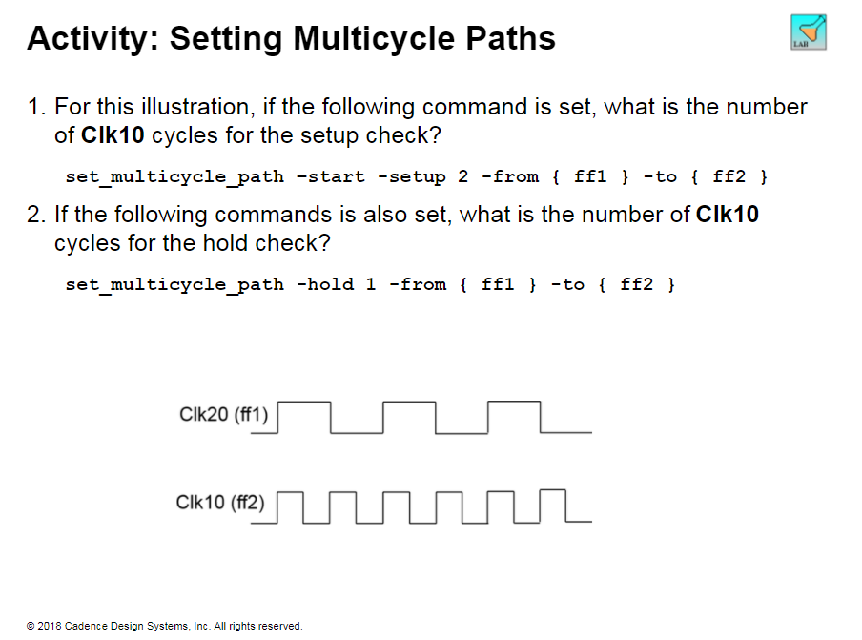

Slide 10
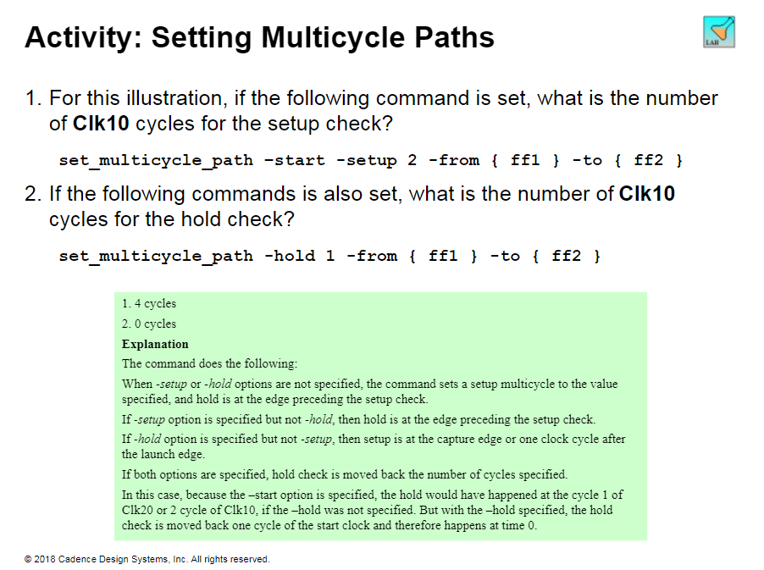

Slide 11
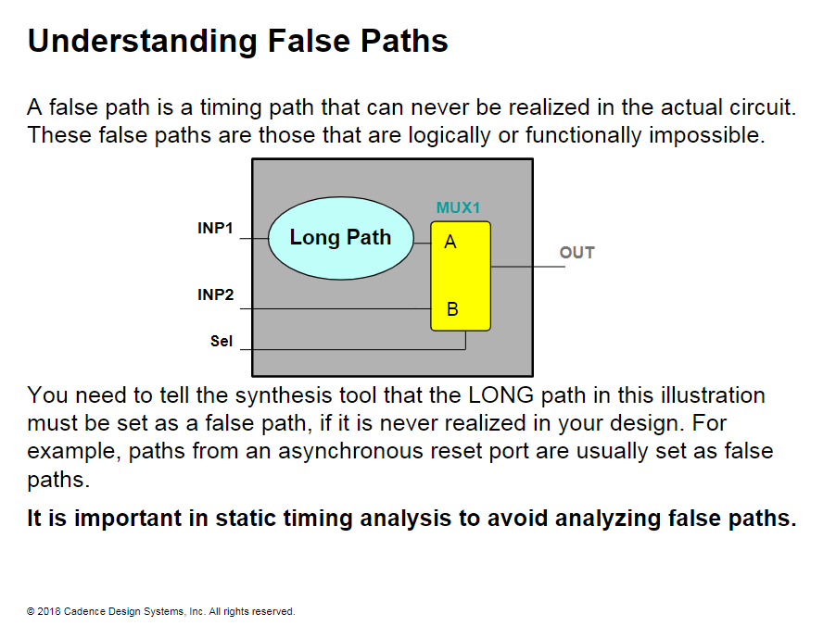
Notes:
Understanding False Paths
You must tell the STA tool which paths are false. eliminating the need for the tool to spend cycles analyzing these paths. Some Cadence® software automatically flags these paths as false, removing the need for an in-depth analysis of such paths by the logic designer.

Slide 12
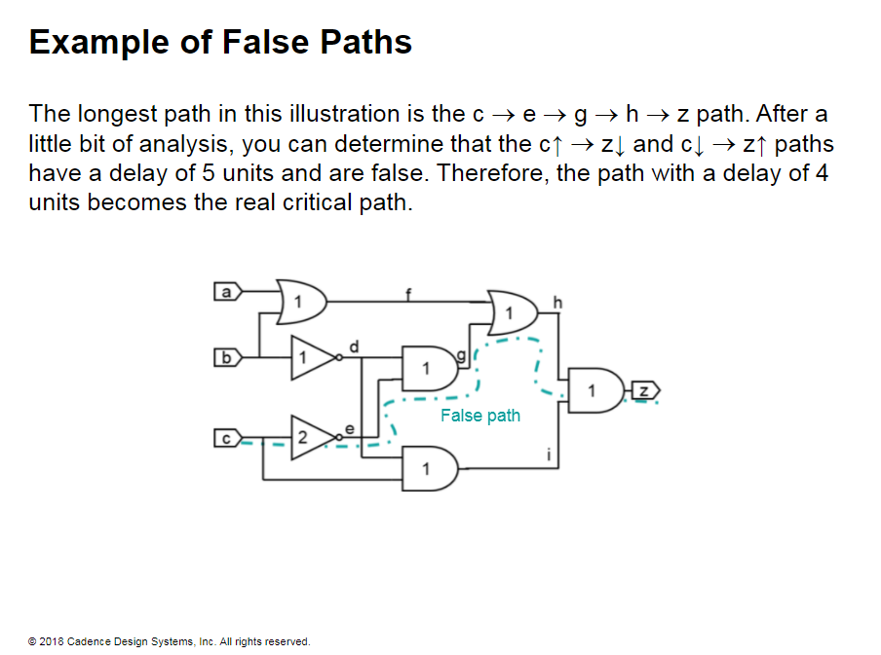
Notes:
Example of False Paths
You can analyze the logic assuming C (C rising). and use all possible combinations of the other inputs. But C does not propagate to the output. Similarly. analyze the logic assuming Cv (C falling). and use all possible combinations of the other inputs. But Cv does not propagate to the output.

Slide 13
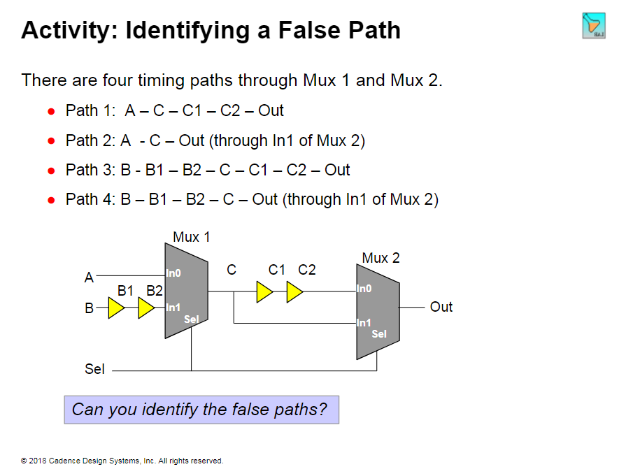

Slide 14
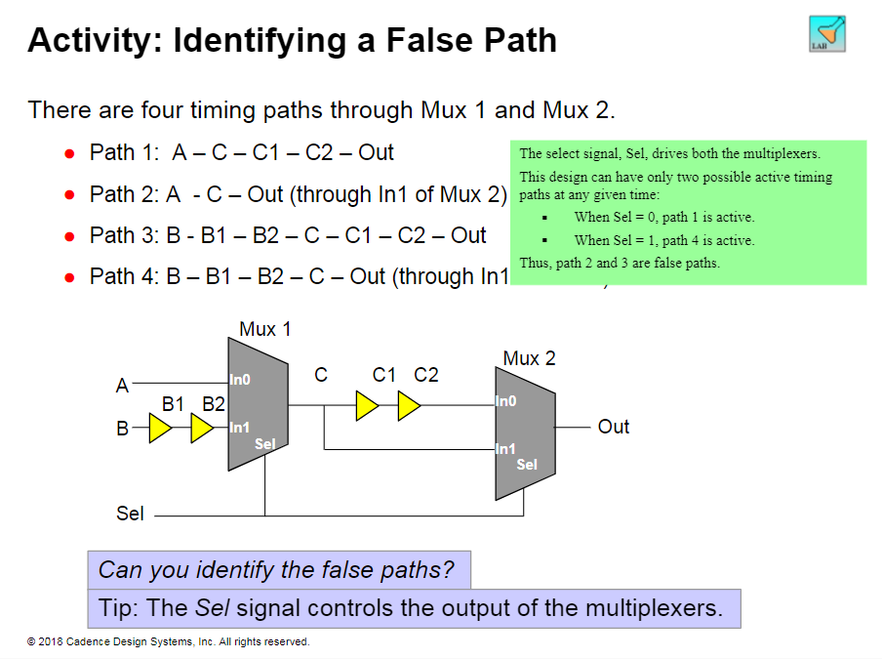

Slide 15
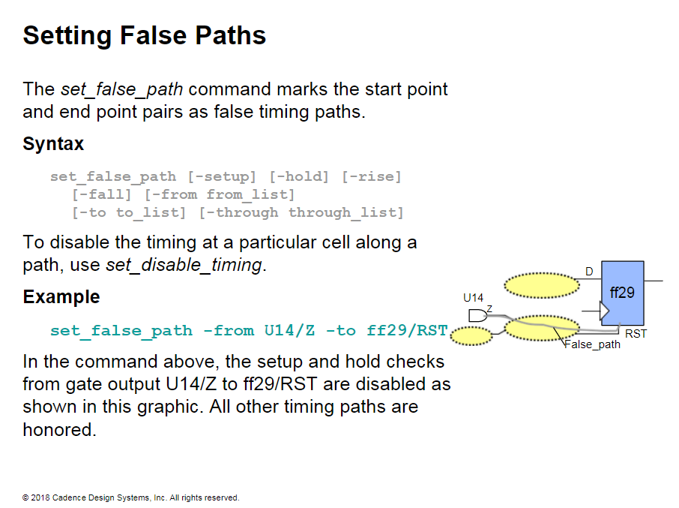
Notes:
Setting False Paths
Essentially disables max delay (setup) and min delay (hold) checks.
False path takes precedence over multicycle path.
Specific set_max_delay or set_min_delay command overrides a general set_false_path command.

Slide 16
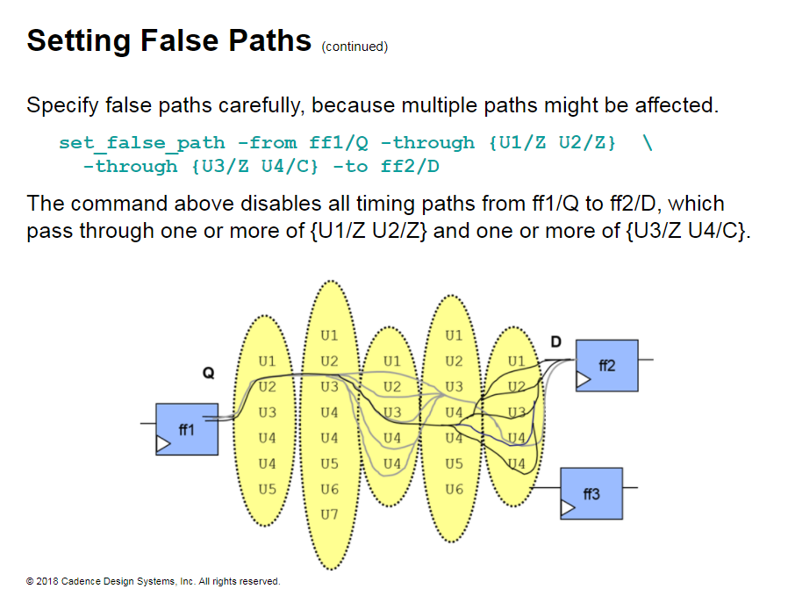

Slide 17
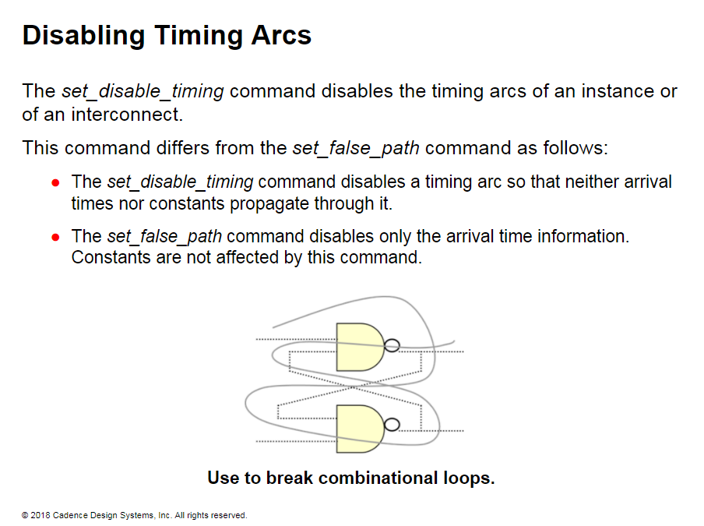
Notes:
Disabling Timing Arcs
In this illustration, the cells form a timing loop. STA tools cannot understand loops. If you disable the timing arcs from the input to the output of the bottom NAND, the STA tool times the delays along the arcs shown in red.
In some design scenarios. a timing arc of a cell might not be used because of a design choice you make, or because you want to improve the timing. In either case. the preference is to disable the timing arc instead of setting a false path.
Setting a false path tells the STA tool that this are still exists but not to time it. Disabling the arc tells the STA tool that this are does not exist in the design even if the library cell contains the timing arc.

Slide 18
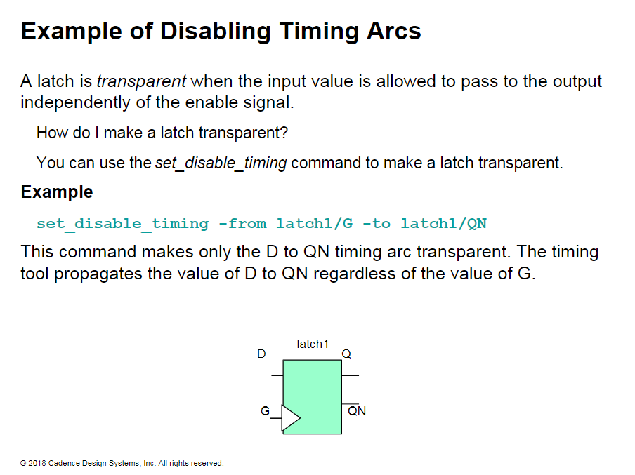
Notes:
Example of Disabling Timing Arcs
A latch is said to be transparent when the input value is allowed to pass through to the output.
Behaves like a combinatorial gate.
Passes constants through the gate.
A latch is opaque when nothing can propagate through the latch.

Slide 19
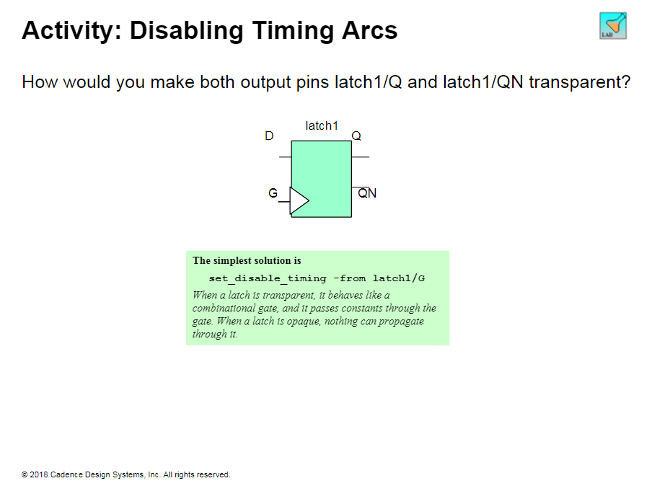

Slide 20
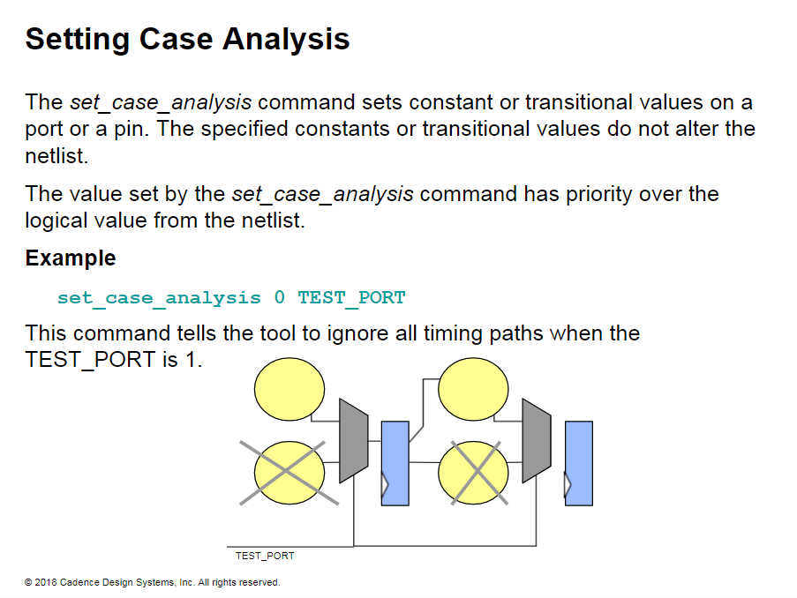
Notes:
Setting Case Analysis
You can use the set_case_analysis command on a port or a pin to set a constant logic value of 1 or 0. You can use this command to propagate constants on a path.
Example
set_case_analys is rising {ul/u2/a u1/u3/ci}
This command tells the STA tool to analyze timing when the U1/U2/A and U1/U3/CI pins have a rising transition. A falling transition on these pins is ignored.
You can use case analysis to prevent large transition times from propagating. whereas you cannot set a false path to prevent transition times from propagating.
A good use of case analysis is to prevent large transition times on a high fanout synchronous reset.
You can set a constant on:
A pin or a port to enable or disable sections of logic.
The sequential output, but the constant cannot propagate through sequential logic.
The input pin of a cell. but the constant does not propagate when a timing arc is disabled using set_disable_timing.

Slide 21
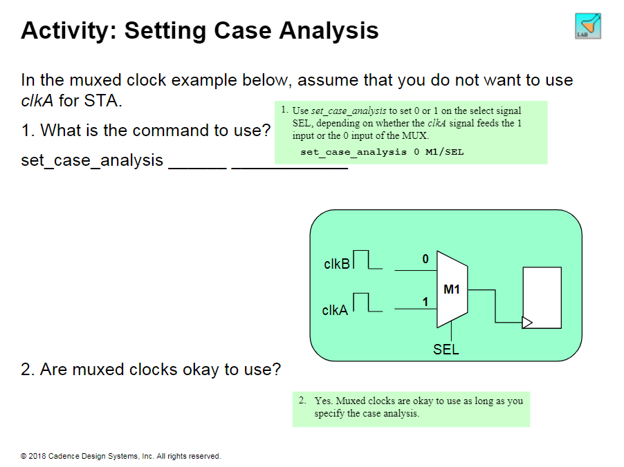

Slide 22
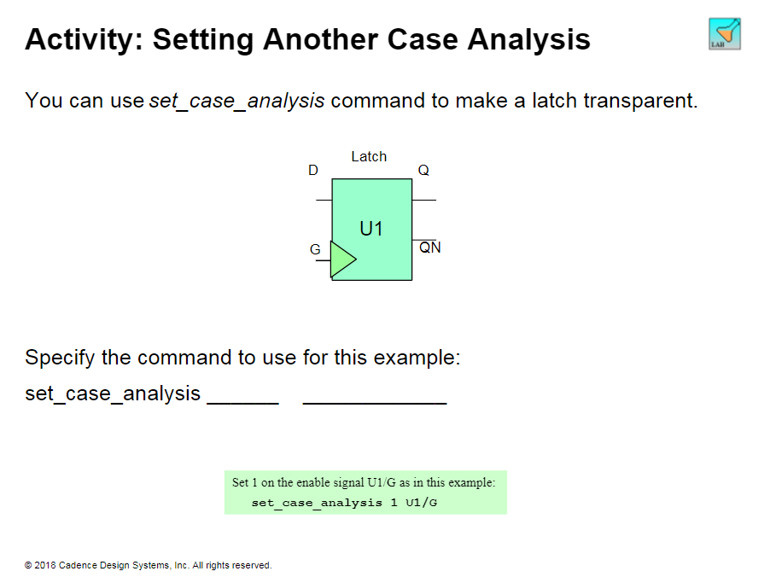

Slide 23
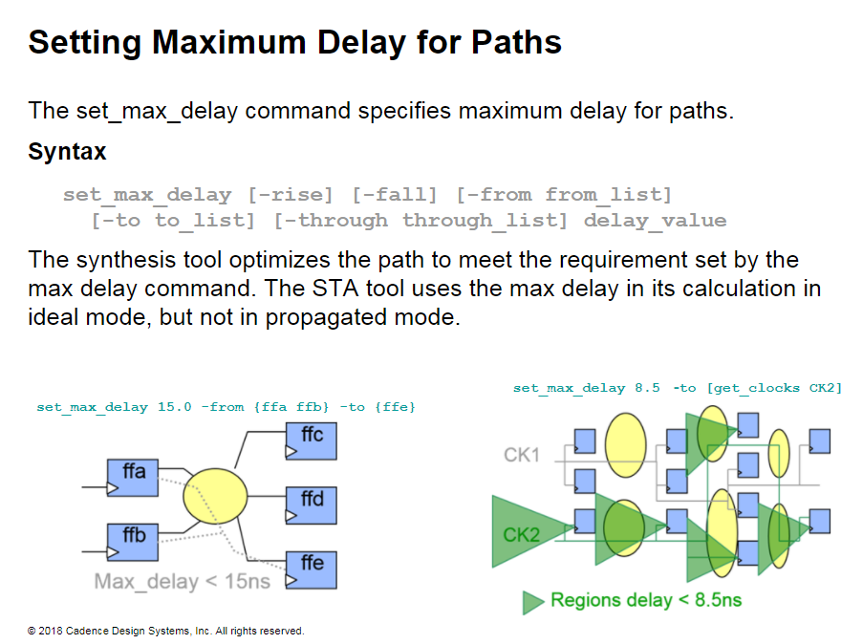
Notes:
Setting Maximum Delay for Paths
The example command on the left forces all paths from ffa or ffb to ffe 15 ns to have a path delay less than 15 ns for the purpose of timing analysis.
The other command forces all paths to the endpoints clocked by CK2 to have a path delay less than 8.5 ns for the purpose of timing analysis.

Slide 24
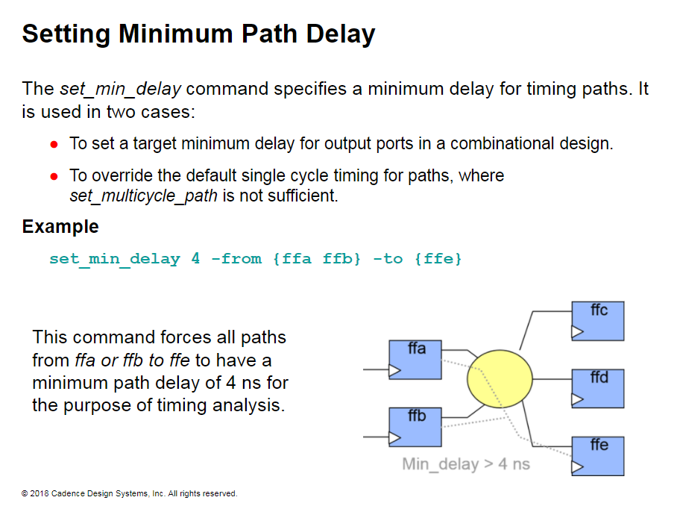

Slide 25
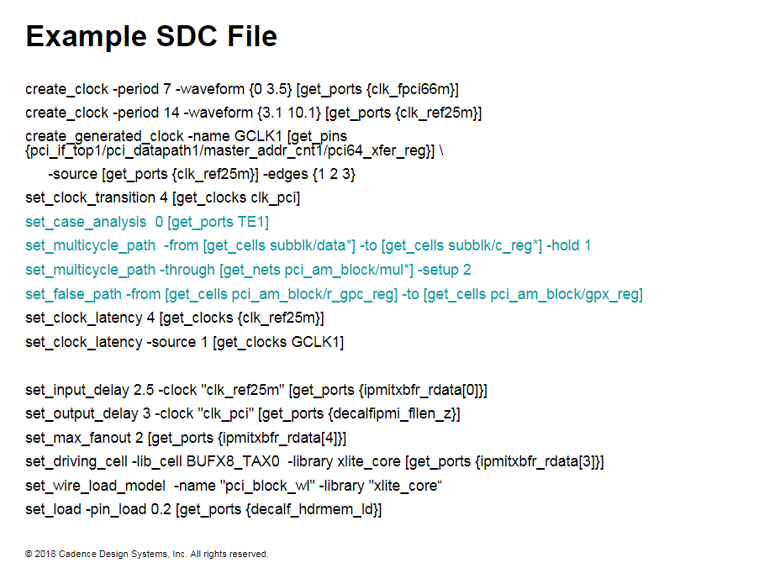
Notes:
Example SDC File
This example SDC file shows a few path exceptions in blue.
The set_case_analysis command sets the TE1 port to 0. In other words. the paths are timed only when TE1 is 0.
The first set_multievele_path command sets a hold multicycle of 1 on all paths from data to reg in subblk.
The second set_multicyele_path command creates a setup multicycle of 2. and a hold multicycle of 1 on all paths through the a/ net in the pci_am instance.
The set_false_path command tells the STA tool NOT to time paths from gpc_reg to gpx_reg in the pci_am instance.

